Slide 1
Working with Dementia Research Grant Fund
Information webinar
21st April 2026

Slide 2
1. About the Working With Dementia Network Plus

Slide 3

Working with Dementia Network Plus Vision
To collaboratively develop innovative and impactful solutions to create meaningful change for individuals affected by dementia in the workplace.
This includes for:
  Employees diagnosed with dementia
  Employees who are caring for someone with dementia
  The organisations and systems who support them

Slide 4
The UK’s Ageing Workforce
Age Group | 35-49 | 50-64 | 65+
2005 | 81.9% | 64% | 5.9%
2015 | 83.9% | 68.9% | 10.3%
2025 | 85.7% | 71.6% | 12.7%
Source: UK Labour Force Survey, Office for National Statistics

Slide 5
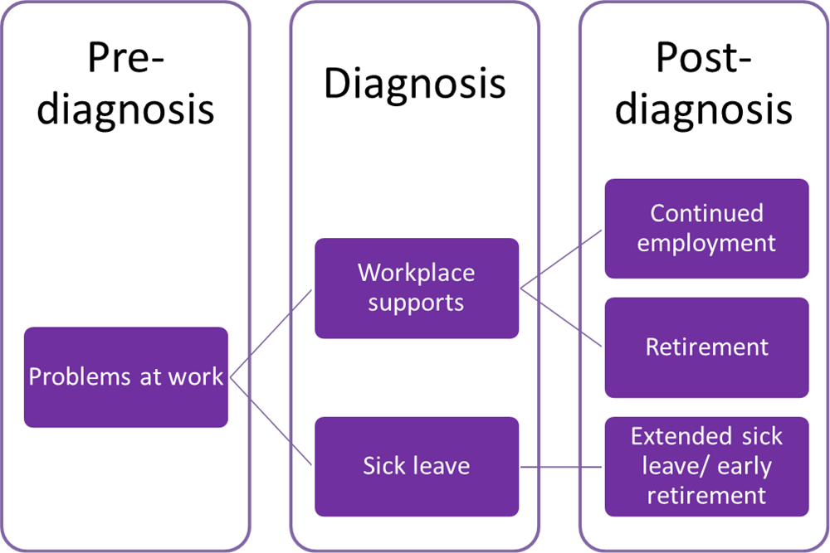
What happens when an employee develops dementia?

Slide 6

Working with Dementia Network Values
Our values are established on the principles of Justice, Equity, Diversity and Inclusion
Living a purposeful life is essential for wellbeing
  We recognise that for many people work provides purpose and is an integral part of who we are.
A diagnosis of dementia does not mean an end to working lives
  People with dementia can and do continue to make a meaningful contribution to work and society and we are committed to challenging stigma around dementia and work.
A transdisciplinary approach is essential to enact positive societal change
  To create change we need to work collaboratively to develop research and practice solutions.
Career development drives sustainability
  We will support early career researchers and deliver inclusive, tailored training to develop research solutions for people living with dementia and their carers now, and in the future.

Slide 7

Working with Dementia Network Plus Themes
Work and Wellbeing
  Exploring the relationship between work, health and wellbeing and explore how to support individuals living with dementia and their carers to continue working.
Inclusive Workplaces
  Collaboratively developing innovative and inclusive employment practices that create labour markets where every individual is empowered to thrive and contribute.
Economic Costs and Benefits
  Providing critical insights into the financial aspects of working with dementia and model sustainable solutions.

Slide 8
2. About the Research Grant Fund

Slide 9
Research Grant Fund – Aims & Objectives
Aims of the Fund:
  To produce transdisciplinary research on dementia and employment where there are defined needs and currently knowledge or evidence gaps.
Objectives of the Fund:
  To support early career researchers to develop their research careers in the area of dementia and employment.
  To inform and support dissemination of research findings that can be translated into real-world impact for those living with dementia and their family carers through policy and practice.
  To enable future funding bids and research projects to continue the pipeline of research in this topic area.

Slide 10
Research Grant Fund – Priority Setting
Priority research areas
The Working With Dementia Network Plus Research Grant Fund has been developed with insights from a priority-setting research project conducted by academics at the University of the West of Scotland.
This research study, using the Nominal Group Technique, conducted a series of focus groups with stakeholders to identify their priorities for improving the work-related experiences of people living with dementia and family carers. Focus groups were conducted with people living with dementia, carers, academics and researchers, policymakers and employers to gain broad insights and identify cross-cutting priorities.
The results of this priority-setting research have been used to inform the focus of this call for proposals, aligned to the Network’s themes of Work and Wellbeing, Inclusive workplaces, and Economic costs & benefits.

Slide 11
Research Theme Priorities
Work and Wellbeing
Research Priorities
The impact of dementia on:
  Personhood and identity in the workplace
    This may include a focus on career transitions and pathways for those living with dementia or caring for someone with dementia
  Agency and employment-related decision-making
  Mental health and social interaction in the workplace
Pre & post-diagnostic support for employment
  This may include a focus on current or proposed guidance, knowledge, and links with employers or employment services

Slide 12
Research Theme Priorities
Inclusive Workplaces
Research Priorities
Individualised assessment, adjustments and flexibility
Education, training, awareness-raising and de-stigmatisation
Workplace policy, guidance, and practical support and signposting
Workplace initiatives
Person-centred and empathetic workplace cultures
  This may include a focus on either/or management structures, peer-to-peer dynamics, organisational or sector-based networks

Slide 13
Research Theme Priorities
Economic Costs & Benefits
Research Priorities
Individual and family finances, as it related to:
  Household income needs, challenges, changes
  Pensions
  Benefits
Organisational economics, as it relates to:
  Recruitment and retention
  Cost-effectiveness for implementation of inclusive practices
  Capacity building and retention of institutional knowledge
Societal economics, as it relates to:
  Demographic and macro-economic trends or data gaps on those of working-age with dementia and carers of those living with dementia
  Policy and legal frameworks
  Employability infrastructure, such as available funding for employers, existing schemes for workplace inclusion, and interconnection between employers, social and health services

Slide 14
Cross-cutting priorities
All applications should also ensure they have considered and demonstrate alignment with the following cross-cutting priorities:
Focus and stakeholder involvement
Focus of research on those who are living with dementia and/or carers of those living with dementia.
Evidence of engagement with stakeholders in the design and/or delivery of the research, such as relevant community groups, employers or employment organisations, social and health services, and those with lived experience.
Justice, Equity, Diversity and Inclusion
Highlighting experiences of different employment types, considering varying organisation types, sizes, sectors as well as those who are self-employed, contract workers, lone workers or remote workers.
Support new insights that promote justice, equity, diversity and inclusion through a focus on the context-specific intersectional needs and barriers of under-represented and minority groups within society and within existing research literature.
  This may include a focus on gender, age, socio-economic status, race and ethnicity, comorbidities and disability, sexual orientation, rural and urban disparities, and experiences related to more rare forms of dementia.

Slide 15
3. Application & review process

Slide 16
Research Grant Fund – Key information
Eligibility
  Projects must be led by a UK research institution, as defined by the UKRI
  Projects should be led by a Principal Investigator defined as an early career researcher (post-doctoral or equivalent experience)
  International collaborators, experienced academics, and non-academic partners (including those with lived experience) involved in research are eligible as co-applicants.
Funding
  Projects are invited to submit proposals up to £50,000 Full Economic Costing (fEC).
  Projects will be awarded based on fEC budget, and are eligible to claim 80% of fEC based on actual costs incurred.
  Funding can be used for all associated costs of conducting research, including direct staff costs (salaries), indirect staff costs (overheads), travel (travel, accommodation, subsistence), consumable costs (goods or services), research involvement costs (at NIHR hourly rate).
Geographic focus
  UK-wide
Research Involvement
  Projects should demonstrate meaningful engagement with relevant stakeholders including lived experience individuals/groups as part of the research.
Duration
  Maximum 12-months from commencement
Application process
  Two-stage: Expression of Interest and invited proposals from EOI shortlist

Slide 17
Research Grant Fund – Important dates
ACTIVITY | DATE
Expression of Interest open | 26th March 2026
Expression of Interest close | 1st June 2026
Feedback provided and shortlist invited to submit full proposal | 7th August 2026
Full proposal deadline | 5th October 2026
Feedback provided and selected projects informed | 27th November 2026
Projects expected to commence by | 1st March 2027

Slide 18
Expressions of Interest
The Expression of Interest phase is designed to support interested projects to share high-level information on their proposed research design. Detailed guidance and EOI template can be found on the Network’s website:
Details requested:
Information on project team, including role in project
Project scope and research design/methods
Expected impact, including any future research
How the project aligns with the Fund’s cross-cutting priorities, and which 1 priority under the Network’s themes it is applying under
Expected resources (not full budget or costing)
Opportunities to identify areas for further Network support:
Stakeholder engagement and lived experience participation
Academic mentorship

Slide 19
Expressions of Interest – review & scoring
Expressions of Interest will be reviewed by a representative panel from the Network’s governance, including our Academic Network Team, Lived Experience Panel, Stakeholder Advisory Group and Early Career Research Forum.
All Expressions of Interest will be reviewed independently against a weighted criteria, scored using a 5-point scale from Poor – Outstanding. Reviewers will meet to assess independent scores, comments, and average weighted scores to determine a shortlist to be invited to submit a full proposal.
Criterion | Weight (%)
Fit to call / strategic alignment | 15%
Need & rationale | 15%
Feasibility of methodology | 40%
Benefit & impact (high-level) | 30%

Slide 20
Full proposal stage
Details of full proposals will be provided to those shortlisted at EOI stage.
Those invited to submit a full proposal will receive feedback from the EOI review panel, providing any insights that may strengthen their full proposal, and be invited to attend tailored webinars on areas including proposal writing, budget development, research ethics & stakeholder involvement in advance of the full proposal deadline.
If applicants selected support with matching with stakeholders or academic mentors as part of their EOI, the Network team will be in touch to suggest connections and facilitate introductions.

Slide 21
Additional expectations
Lead principal investigators of successful selected projects will be expected to join the Network’s Early Career Researcher Forum to support their continuous development.
From the point of notification of successful funding, projects should begin ethical approval processes to ensure these are secured before project commencement.
Projects will be funded based on UKRI standard terms & conditions. Those invited to submit full proposals will be provided with draft terms & conditions for review of relevant legal teams in your institution(s) to ensure these can be adhered to if successful, to avoid delays in contracting.
Projects will be expected to report on research activities and outcomes as well as financial records. The Network team will provide guidance, support and relevant training on reporting expectations prior to project commencement.

Slide 22
Thank you!
Any questions?

